Slide 1
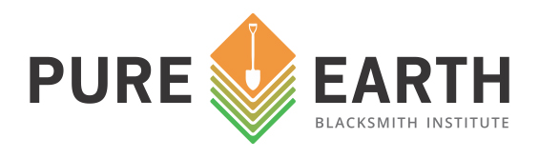
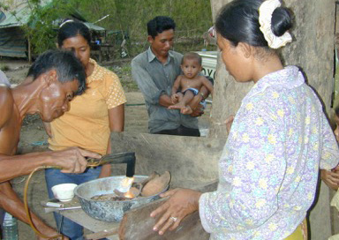
The Campaign for 10 Million Lives
A Three-year Strategy (2016-2018)
This artisanal miner is burning an amalgam of gold and mercury, releasing toxic mercury fumes into the air. This work is often done in backyards and communities, exposing family members. Including babies like the one pictured here.
MERCURY POLLUTION FROM ARTISANAL GOLD MINING
The Problem: More than 19 million people are at risk of mercury poisoning, and the effects are irreversible. Children are especially vulnerable. The toxin attacks the central nervous system and many organs, which can result in serious birth defects and brain damage. Furthermore, mercury travels across the globe when released into the air affecting millions of unsuspecting people, by contaminating water bodies, soils, and crops.
Artisanal and small-scale gold mining is the leading source of mercury pollution, accounting for 30% of the global emissions. Small-scale gold miners work with few regulations or illegally to make a meager living. Miners mix and burn off toxic mercury during the gold mining process, as the element helps to extract gold from ore.
Plan of Action: For 10 years, Pure Earth has worked to reduce mercury emissions from artisanal gold mining in low-income communities around the world. We have identified the sites that pose the greatest risk to human health and have implemented pilot programs training miners in mercury-free mining methods. These programs have demonstrated tremendous success resulting in miners extracting up to 50% more gold and a waiting list of mining communities requesting training. We want to continue and expand this work.
Where
What
Impact
Cost
Peru, Mongolia and Indonesia
Three long-term replicable programs which will:
• educate communities about the health risks from mercury,
• teach miners mercury-free or reduced gold mining methods,
• remediate mercury-poisoned sites, and
• coordinate country-wide plans to facilitate a scaled up transition to mercury-free mining.
Participate in global efforts to reduce mercury poisoning and enable responsible sourcing of mercury-free gold.
135,000 lives impacted
$1.4 million in private support, with leverage potential of $5.6 million in governmental support.

Slide 2
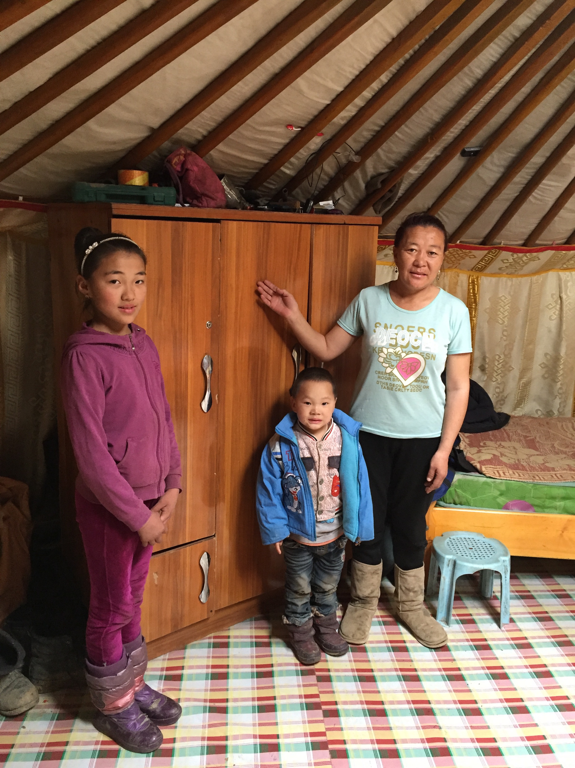
Peru
Artisanal and small-scale gold mining (ASGM) is a traditional livelihood in Peru, providing much needed income for many impoverished communities. Currently, the prevailing method of ASGM in the country involves using large amounts of mercury to extract gold. These activities result in the release of tons of mercury each year, causing significant air, soil, and water contamination and severe health impacts on local communities.
Pure Earth is working to strengthen the capacity of the Government to do both, with a particular focus on reducing the adverse impacts of mercury and ASGM on the environment and local communities, and sustainably restoring affected natural resources. The project, which is funded in part by the U.S. Department of State, will assist the government to assess ASGM sites for contamination and degradation, develop community-drive remediation plans and strategies for alternative livelihoods and mercury-free ASGM practices, and conduct remediation and rehabilitation of contaminated and environmentally degraded ASGM sites.
Indonesia
YTS, a local NGO with strong connections to the communities and the local authorities, has been working with Pure Earth support to expand the use of mercury retorts and water-box condensers in the artisanal mining areas, in order to reduce the amount of mercury used and the consequent health impacts. These reduced mercury methods have been well-received, by the mining bosses as well as the miners themselves and there is ongoing expansion of the coverage of the scheme and the numbers of miners involved.
Looking forward, we want to train miners in mercury-free methods, remediate contaminated spaces in residential areas, and provide community education. In addition, the Asian Development Bank funded Pure Earth to develop plans to integrate environmental management with urban redevelopment in Jakarta, with the goal to mitigate hazardous waste exposures.
Mongolia
Over the last 20 years, Mongolia has experienced a surge in the number of people engaging in the practice of small-scale and artisanal gold mining. Since 1990, the number of miners has increased from zero to an estimated 100,000, and currently represents 20% of the rural workforce. Like independent miners around the world, many of these miners use mercury to separate gold from the soil and rock that surrounds it, and as with other ASGM locations, both the environment and public health have suffered.
Pure Earth received support from the European Union to train miners in mercury-free methods, and conduct environmental assessment trainings with environmental inspectors from provincial governments to help them identify toxic pollution and enforce environmental regulations.. The total number of miners trained during three years exceeded 1,250 miners. Moving forward, Pure Earth is seeking funds to collaborate with the government on a comprehensive plan that includes expanded training in mercury-free methods as there is a waiting list of mining communities that want to be trained.
.
A MONGOLION MOTHER’S STORY:
Ms. Altantuya is a single mother living with her daughter Sanchitrmaa (10 years old) and her son Enkhbaata (3 years old). She and her husband were rural herders, but lost their livestock during the winter of 2009. They moved Zaamar, the largest mining area in Mongolia, for work.
Without many skills, they became gold miners, using mercury illegally. Then, unexpectedly, Ms. Altantuya's husband died, and her life became extremely stressful. She struggled to put food on the table and feared going to jail for using mercury.
Everything turned around after she participated in a Pure Earth workshop training her in mercury-free mining methods. Now, not only does she extract more gold using the clean method, but she can work closer to home and take care of her children.

